Slide 1
CROWDFUNDING USING BLOCKCHAIN
TEAM MEMBERS 1. Anuj Arora (44814802718)
2. Jatin Malhotra (41914802718)
3. Rhythm Jayee (75114802718)
GUIDE - Ms. Mini Agarwal CO-GUIDE - Ms. Anubha

Slide 2

PROBLEM STATEMENT
The purpose of this project is to develop a decentralized Crowdfunding platform using ethereum blockchain technology which provides a better system to handle the flaws in the existing system of crowdfunding platforms like kickstarter, by protecting the interest of Contributors as well as Project manager.

Slide 3
ABSTRACT
Crowd funding is an online cash raising technique that started as a path for the people to contribute limited quantity of money to enable innovative individuals to fund the venture. Using crowdfunding, people can put resources into pioneering businesses through a middle medium or platform. The issue with the current crowdfunding technique is that, third party medium don’t give the assurance of the money investor contributed and also the time spent on voting system by the contributors adds to the delay of the project.

Slide 4
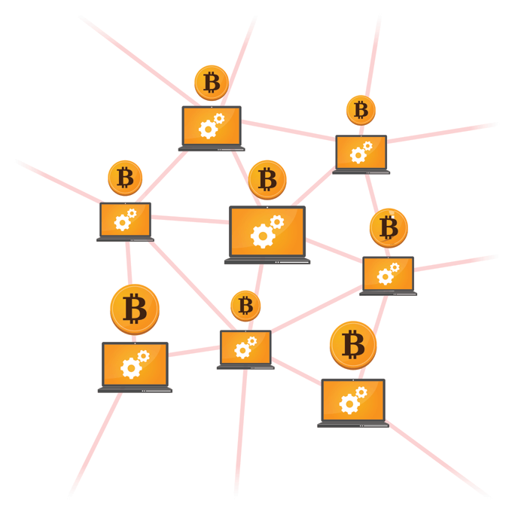
INTRODUCTION
SCOPE :
Decentralization : No individual platform or group of platforms control the smart contracts which makes it transparent to everyone in the blockchain .
Peer to Peer network : Follows to a protocol for inter-node communication and validate new block, so no one can alter any block without approval of more than 50 percent nodes in the blockchain which makes it secure and safe.
Easy to Use : Any one can create the project in the website with blockchain and any one who has internet connectivity can donate to the project. Contributors do not have to worry about the empty promises like the traditional crowdfunding.

Slide 5
MOTIVATION :
Frauds on crowdfunding platforms like kickstarter.
Do not ensure that the promise will be met.
CHALLENGES :
Emerging Technology : Blockchain is still emerging technology which is in exploratory stage and there are many technical and legal issues.
Room for Improvement : Blockchain business and market influencers to work together and change the business, deploy blockchain technology in market, and introduce innovative ideas.
Lack of Understanding of blockchain innovation : Businesses have to develop their understanding of blockchain innovation, it’s worth, its chances, and its dangers.

Slide 6
Literature survey
Blockchain :
A blockchain is a growing sequence of blocks, that are connected together using cryptography. Each block calculates the hash using some cryptographic method, a hash of previous block, a period stamp of when it is made. Blockchain doesn’t permit any alteration of the information in the block. Thus, blockchain solves the problem of spending more as there is no need of any central server or trusted authority.
Smart Contracts :
Smart contracts are simply programs stored on a blockchain that run when predetermined conditions are met. They typically are used to automate the execution of an agreement so that all participants can be immediately certain of the outcome, without any intermediary's involvement or time loss.

Slide 7
TECHNOLOGY STACK
React.js - A Javascript library for building user interfaces for modern web applications.
Node.js - It is a platform built on Chrome’s Javascript runtime for easily building fast and scalable network applications.
Next.js - It is a React Based framework with server side rendering capability. It is very fast and SEO friendly.
Solidity - It is a contract-oriented, high-level programming language for implementing smart contracts.
Ethereum - It is a decentralized, open-source blockchain with smart contract functionality.Ether is the native cryptocurrency of the platform.

Slide 8
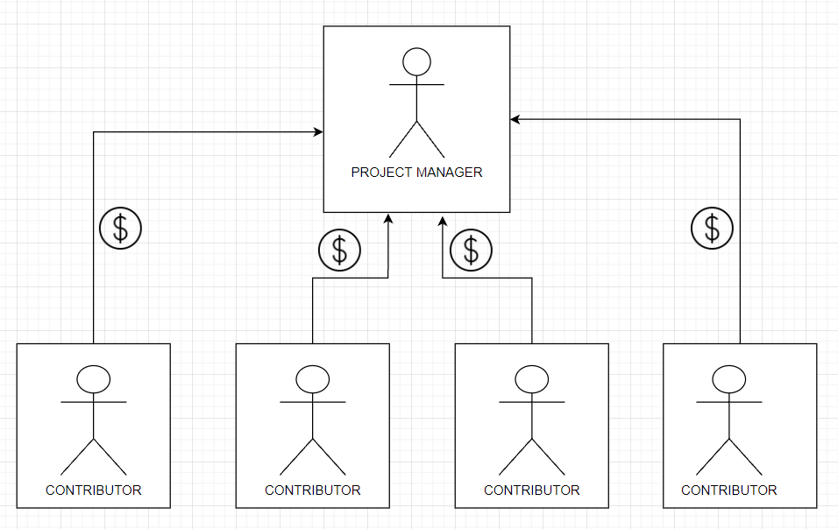
ARCHITECTURE (TRADITIONAL)

Slide 9
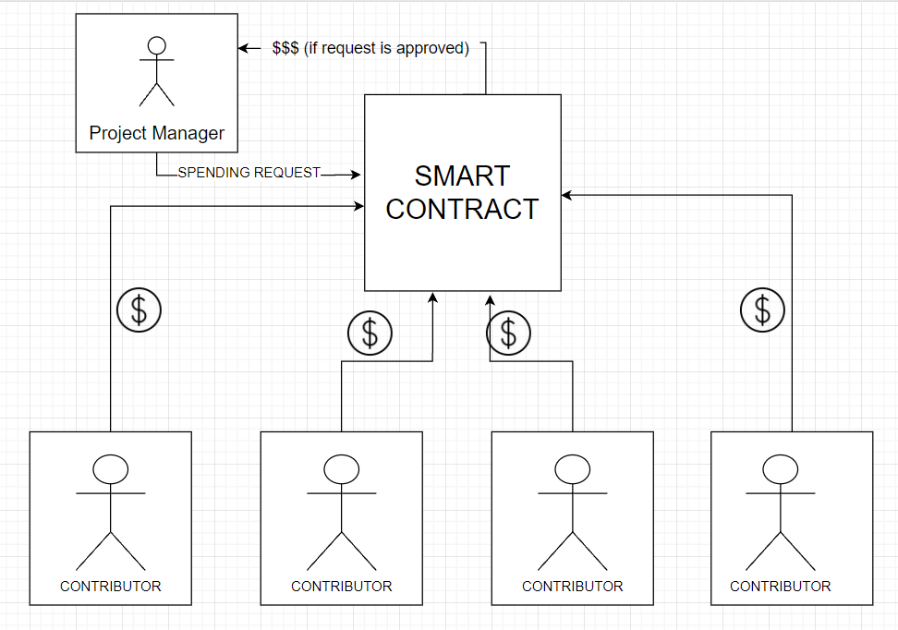
PROPOSED ARCHITECTURE

Slide 10
References
[1] Shuai Wang, Liwei Ouyang, Yong Yuan, “Blockchain-Enabled Smart Contracts: Architecture,Applications, and Future Trends” , IEEE Trans. on Sys. Man and Cybernetics, Feb 2019, 2168-2232.
[2] Vitalik Buterin,“A Next-Generation Smart Contract and Decentralized Application Platform” [ Online].Available: https://github.com/ethereum/wiki/wiki/White-Paper
[ 3] S. Nakamoto, “Bitcoin: a peer-to-peer electronic cash system”, [ Online]. Available:https://bitcoin.org/bitcoin.pdf.
[ 4] Bhabendu Kumar Mohanta, Soumyashree S Panda, Debasish Jena, “An Overview of Smart Contract and Use Cases i n Blockchain Technology” , 2018 9th International Conference on Computing, Communication and Networking Technologies (ICCCNT), Oct 2018, 978-1-5386-4430-0.

Slide 11
THANK YOU

